Slide 1
THE SWE FINAL PROJECT PRESENTATION
Going Anywhere APP
Group 3: Old folks

Slide 2
PART 01
Project Introduction

Slide 3
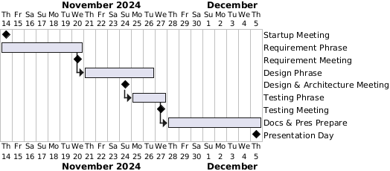
Project Introduction
Project Name:
Going Anywhere APP
System Category:
Airline Ticket Sales & Management
Team Member:
Cheng Bao(1335784), as “project manager”
Xinxin Qiu(1335785), as “development manager”
Dinggen Zhang(1336574), as “Architector & Testing manager”
The software provides a platform for users who want to travel by air and want to find all possible choices they have in one place.
The software will gather flight information from all avaliable airlines, give users a list of tickets that they can buy according to their search settings, and complete the processes of purchasing, changing, refunding and boarding of their tickets.
Notes:
@startgantt
label on last column
project starts 2024/11/14
[Startup Meeting] happens at 2024/11/14
[Requirement Phrase] starts at 2024/11/14 and ends at 2024/11/20
[Requirement Meeting] happens at 2024/11/20
[Design Phrase] starts at [Requirement Phrase]'s end and ends at 2024/11/26
[Design & Architecture Meeting] happens at 2024/11/24
[Testing Phrase] starts at [Design & Architecture Meeting]'s end and ends at 2024/11/27
[Testing Meeting] happens at 2024/11/27
[Docs & Pres Prepare] starts at [Testing Phrase]'s end and ends at 2024/12/5
[Presentation Day] happens at 2024/12/5
@endgantt

Slide 4
PART 02
User Requirements

Slide 5
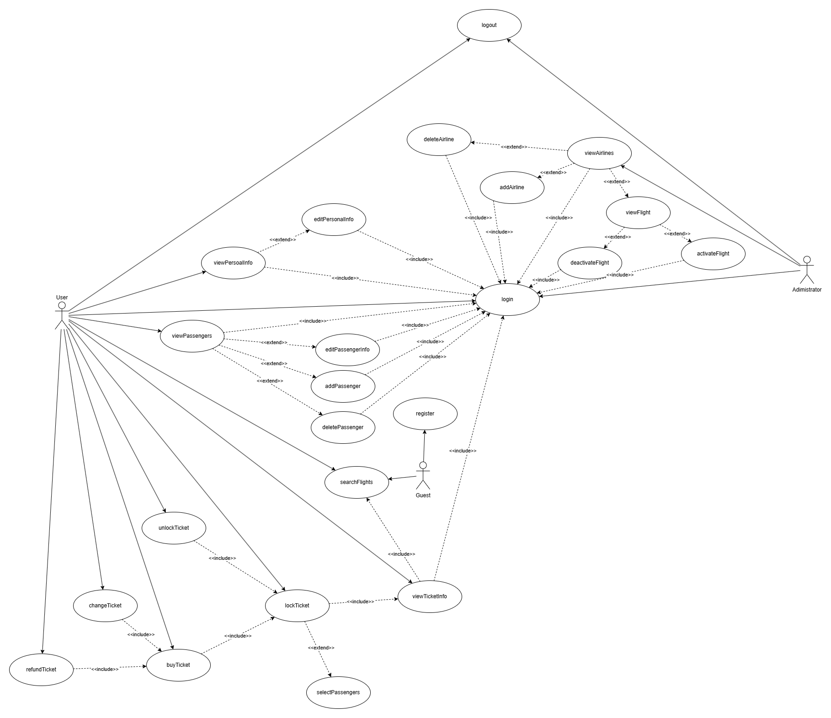
User Requirements Overview
User Roles:
Guest:
Search available tickets of the flights
Register to become a user of the system
User:
Login / Logout
Search available tickets of the flights
Maintain a list of passengers (CURD)
Book / Cancel / Buy / Refund / Change the tickets
View the status of the tickets
Administrator:
Login / Logout
Maintain the airlines (CURD)
Activate / Deactivate the flights of chosen airlines
*CURD: Create, Update, Read, Delete

Slide 6
User Requirements Overview
User Roles:
Guest:
Search available tickets of the flights
Register to become a user of the system
User:
Login / Logout
Search available tickets of the flights
Maintain a list of passengers (CURD)
Book / Cancel / Buy / Refund / Change the tickets
View the status of the tickets
Administrator:
Login / Logout
Maintain the airlines (CURD)
Activate / Deactivate the flights of chosen airlines
*CURD: Create, Update, Read, Delete

Slide 7
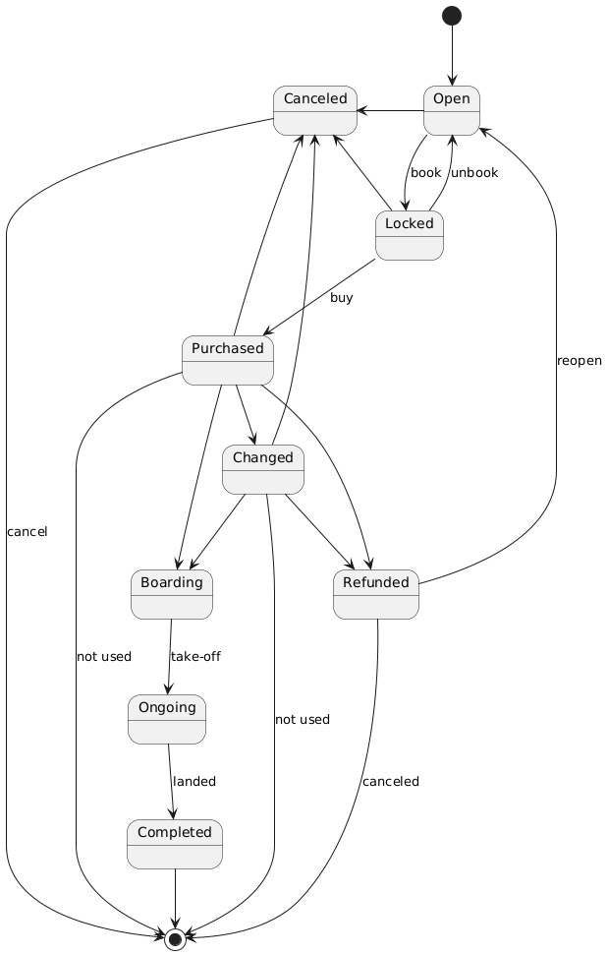
Ticket State Specification
The states of the ticket includes the following:
Open: Ticket is open for sale or unlocked.
Locked: Ticket is locked by a user but not purchased yet.
Canceled: Ticket is canceled by airline or administrator.
Changed: Ticket is changed by user.
Refunded: Ticket is refunded by user.
Boarding: Ticket is checked in by user.
On-going: Flight of the ticket is already take-off.
Purchased: Ticket is already bought.
Completed: Flight of the ticket is landed, and the ticket is completed.

Slide 8
Ticket State Specification
The states of the ticket includes the following:
Open: Ticket is open for sale or unlocked.
Locked: Ticket is locked by a user but not purchased yet.
Canceled: Ticket is canceled by airline or administrator.
Changed: Ticket is changed by user.
Refunded: Ticket is refunded by user.
Boarding: Ticket is checked in by user.
On-going: Flight of the ticket is already take-off.
Purchased: Ticket is already bought.
Completed: Flight of the ticket is landed, and the ticket is completed.

Slide 9
PART 03
System Design

Slide 10
Overview
This presentation outlines the modules of the system designed for flight and ticket management.
The goal of the system is to enhance user experience, streamline ticket booking processes, and enable efficient airline management.

Slide 11
Key Modules & Their Functions
A. Account Management Module
1. User Registration
• Allows guests to register with unique usernames and emails.
• Validates input data and generates a user ID.
2. Login and Logout
• Secure login portal for users and administrators with session management.
3. Profile Management
• Users can view and edit personal information.
• Passenger list management: add, edit, or delete associated passengers.

Slide 12
Key Modules & Their Functions
B. Ticket Management Module
1. Flight Search
• Guests: Limited search results.
• Registered users: Full flight details, including ticket availability.
2. Ticket Operations
• Lock/Unlock tickets to secure bookings temporarily.
• Purchase tickets with payment processing.
• Refund, change, or view ticket statuses like Purchased, Refunded, Boarding, etc.

Slide 13
Key Modules & Their Functions
C. Airline and Flight Management Module (Admin)
1. Airline Management
• Add, delete, and view airlines.
• Deactivated flights by default until activated.
2. Flight Management
• Activate/deactivate flights and manage flight statuses.

Slide 14
Key Features of the Design
1. Dynamic User Roles: Distinction between Guest, User, and Administrator.
2. Comprehensive Ticket Status Tracking: From Open to Completed.
3. Passenger-Centric Design: Link passengers to users for smooth ticket assignment.

Slide 15
Scalability & Security Features
1. Scalability:
• Modular design allows for adding new functionalities like discounts or loyalty programs (Encourage customers to make repeat purchases or stay loyal to a specific brand or service).
• Database normalization ensures efficient data retrieval.
2. Security:
• Credential validation during login.
• Secure session handling for both users and administrators.
• Restriction on sensitive operations like ticket locking to authenticated users.

Slide 16
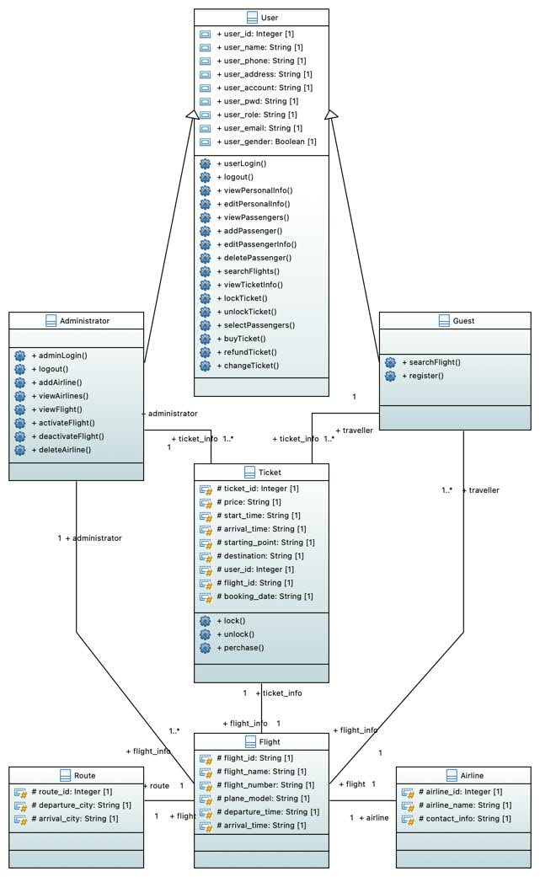
Class Diagram

Slide 17
Conclusion
The system is designed to offer a seamless experience for users and administrators. With structured modules and clear entity relationships, it ensures usability, scalability, and operational efficiency.

Slide 18
PART 04
System Architecture

Slide 19
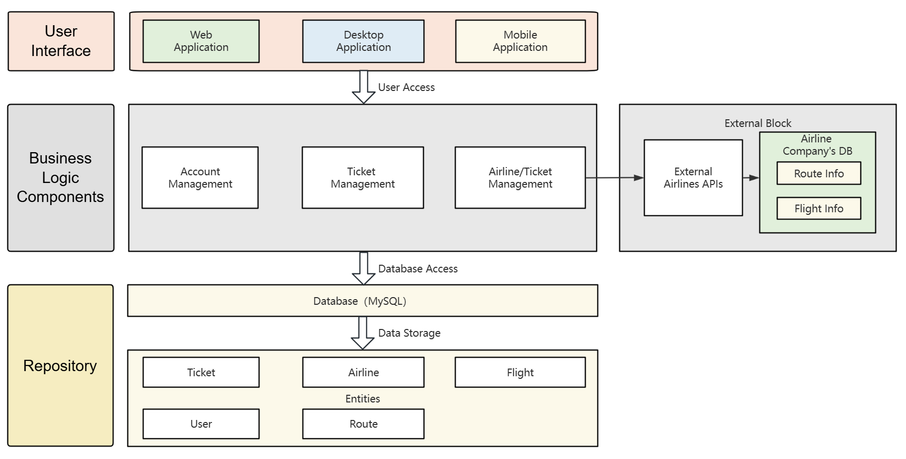
Architecture

Slide 20
Layer Model(Main)
Layered Model Summarize
The layered model divides the system into layers, with each layer representing a set of related functions.This model helps to separate concerns and allows different parts of the system to be developed and maintained independently.
Strengths Analysis
Modularity: Each level can be developed and tested independently of the others.
Maintainability: Changes at each level do not affect other levels, reducing maintenance costs.
Scalability: New layers can be easily added or existing layers can be modified to suit new needs.
Layers
The UI layer includes web application, desktop application and mobile application components that are responsible for user interface and presentation logic.
The business logic layer includes user management, ticket management and airline management components that handle business rules and logic.
The Repository layer is the database component, responsible for data persistence and storage.

Slide 21
Repository Model
Introduction
Examples of applications
Advantages
Repository Model is a data access design pattern , by centralizing the data access logic in one place , so that the business logic layer decoupled from the specific data access technology .
In the User Management, Ticket Management, and Airline Management components, the use of the repository pattern encapsulates access to the database so that these components do not need to know the specific details of the database implementation 。
Decoupling: The business logic layer is decoupled from the data access layer, improving the maintainability and testability of the code.
Flexibility: Easy to update and maintain the database without affecting the business logic layer.

Slide 22
UI Layer
Web Application
Desktop Application
Mobile Application
01
02
03
Web Application is a browser-based user interface that allows users to access the system via the Internet.The front-end pages include login, registration, and ticket purchase pages, and rich interactive functions are realized through JavaScript, HTML and CSS.
Desktop Application provides an interface to a desktop application that needs to be installed on the user's computer.Such applications typically have richer functionality and a better user experience, and are suitable for tasks that require frequent operations and data processing.
Mobile Application is a mobile application interface designed for smartphones or tablets.Mobile applications are characterized by convenience and real-time availability and are suitable for use in mobile scenarios, such as checking flight information, purchasing tickets and refunding tickets.

Slide 23
Business Logic Layer
User Management
User Management handles user-related business logic, including user registration, login, logout, viewing and editing personal information, and managing passenger information.This module protects system data security by verifying user identity.
Ticket Management
Ticket Management handles the business logic associated with airline tickets, including searching for flights, viewing available tickets, locking/unlocking tickets, selecting passengers, purchasing tickets, refunds and exchanges.This module needs to interact with the UI and database layers to realize complex business requirements.
Airline Management
Airline Management handles business logic related to airlines, including viewing airline listings, adding airlines, viewing flight details, activating/deactivating flights, and deleting airlines.The module needs to call external airline APIs to get real-time flight information to ensure the accuracy and timeliness of the data.

Slide 24
Repository Layer
Database
Entities
Repository Layer uses a MySQL database to store the application's data.The database design follows normalization principles to ensure data consistency and integrity.The database consists of several tables, such as User, Ticket, Flight, Airline, and Route, each with explicit primary and foreign key constraints.
Entities are the basic objects in the database, including Tickets, Airline, Flight, User, and Route.Each Entity corresponds to a table in the database, and the fields in the table define the attributes and relationships of the Entity.

Slide 25
Database Design
Introduction to DBML
Syntax Definitions
Application scenario
DBML (Database Markup Language) is a text markup language used to describe the structure of a database.With DBML, you can define tables, fields, associations, constraints and indexes in a database.
DBML uses a simple textual syntax that is easy to understand and implement.By defining tables and fields, data structures in a database are represented in an abstract way, thus facilitating database design and management by designers and developers.
DBML is primarily used in the database design phase, especially in scenarios where the database structure needs to be documented and communication with other team members is required.With DBML, database changes can be effectively managed and tracked to improve the efficiency of development and maintenance.

Slide 26
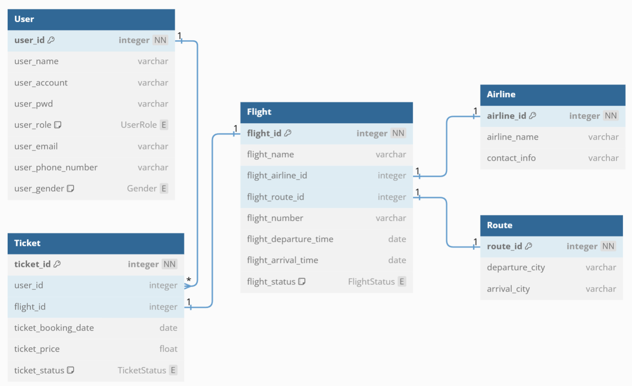
Database Design

Slide 27
PART 05
Testing

Slide 28
Testing
1.Development Testing
Unit testing: Testing for the functionality of a single module or class in the software.
Component testing: testing whether the integrated components work together.
System testing: Testing the functionality and interaction of all components of the whole system after integration.
2. Release Testing
Requirements base testing: Ensure that the software realizes all the specified requirements.
Scenario Testing: Simulates actual user scenarios to test the response of the software.
Performance testing: Test the performance of the software under the expected load.
3. User Testing
Practical use testing: Let users actually operate the software and collect feedback.
Acceptance testing: Users confirm whether the software meets their business needs.

